Slide 1
DEFINE
MEASURE
ANALYZE
IMPROVE
CONTROL
PROBLEM STATEMENT
BIG Y: BALL GUIDE CONSUMPTION NOT MANAGED AS PER PLANNING
MASTER BLACK BELT : MR. ALOK SHARMA
CHAMPION : MR. LATESH GOYAL (PLANT HEAD)
GREEN BELT : ANKIT SAKLANI, GAURAV SHARMA, ANKIT (Project Leader)
COMPANY : TOYOTA BOSHOKU DEVICE INDIA PVT LTD.
BUSINESS : SEAT SLIDER, SEAT RECLINER
SUPPORT TEAM MEMBERS : MR. RAJESH SAN (LAB)
TECH Y (NARROWED PROBLEM STATEMENT):
BALL GUIDE CHANGE AFTER UPPER & LOWER RAIL CHANGE IN ASSY. LINE
CTP: AT DURING BALL GUIDE INSERT IN SEAT TRACK MACHINE
CRITICAL TO (QUALITY,COST,DELIVERY, SATISFACTION OF CUSTOMER) :-
CRITICAL TO QUALITY / CRITICAL TO COST
TARGET:-
BALL GUIDE DOES NOT CHANGE EVEN UPPER & LOWER RAIL CHANGE
SIGMA LEVEL INCREASE – Min. 1 SIGMA
CURRENT SIGMA-
ACTION START : 09/12/2024
MEASURE: >> 18/12/24 TO 17/01/25
ANALYSE: >> 18/01/25 TO 23/02/25
IMPROVE: >> 24/02/25 TO Pending
CONTROL: >> Pending
PROJECT TENTATIVE END DATE :
COPQ CALCULATION;
PRODUCTION /DAY : 25000 nos.
BALL GUIDE USE/ DAY : 100000 nos.
COST OF 1 BALL GUIDE : ₹ 2.73
NO OF DAYS OF EXCESS INVENTORY : 15 DAYS
COST TO COMPANY : ₹ 40.95 Lakh

Slide 2
MONTH-WISE BALLGUIDE CONSUMPTION
DEFINE

Slide 3
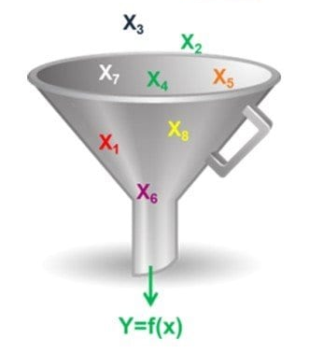
What :- BALL GUIDE CONSUMPTION IS NOT MANAGE AS PER THE PLANNING Who:- SCM PERSON When:- DURING RAIL CHANGE Where :- SEMI AUTO MACHINE AT SEAT SLIDER ASSY. LINE Why:- SLIDING FORCE OUT OF SPEC. (14.7 - 50.0 KN) How :- VARIATION IN ROLLING FRICTION BETWEEN BALL & RAILS How Much:- BALL CONSUMPTION FLUCTUATION 9% TO 21%
DEFINE
BIG-Y
TECH-Y
FORCE VARIATION

Slide 4
WE CONDUCT 30 PART OF YY8 TOOL FOR CHECK FORCE VARIATION IN SAME BALL GUIDE(BALL SIZE-5.5mm)
MEASURE

Slide 5
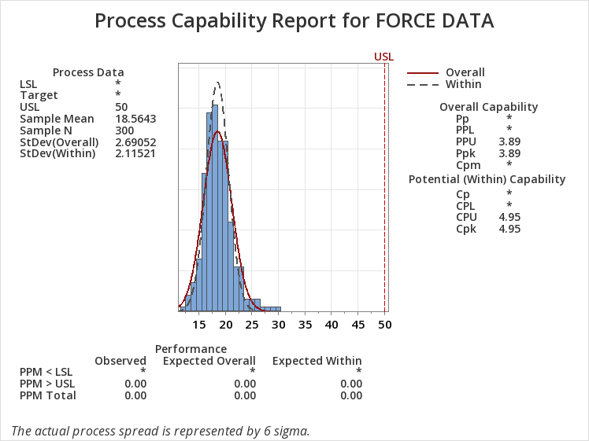
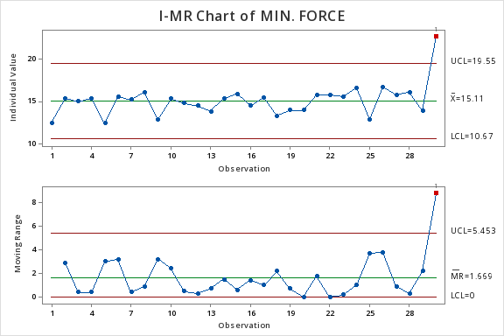
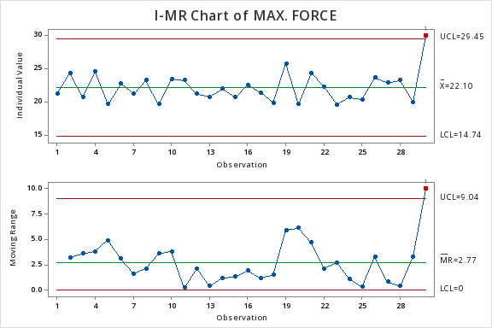
MEASURE
YY8 RAIL FORCE DATA AT 5.5 MM BALL GUIDE
Cpk value is 4.95

Slide 6
WE CONDUCT 30 PART OF YFG TOOL FOR CHECK FORCE VARIATION IN SAME BALL GUIDE(BALL SIZE-5.5mm)
MEASURE

Slide 7
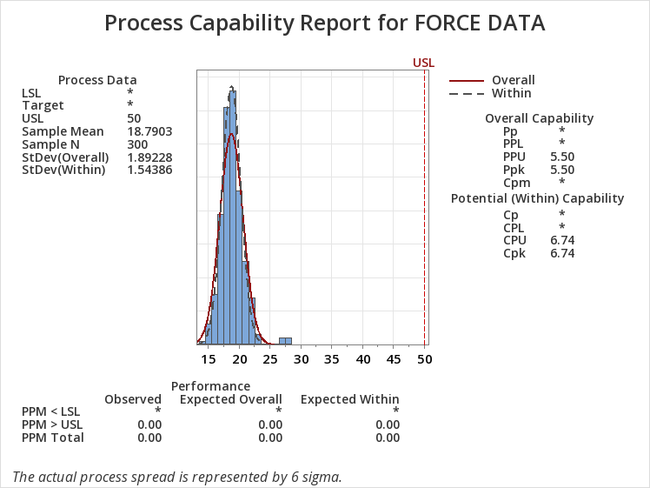
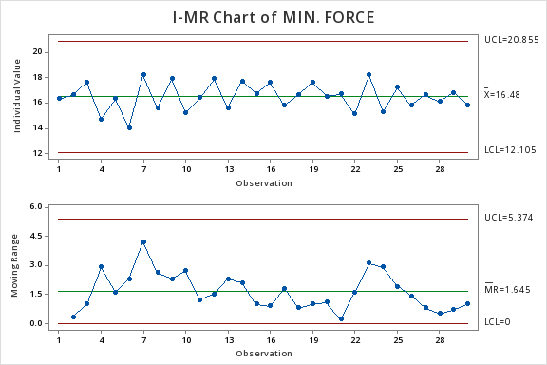
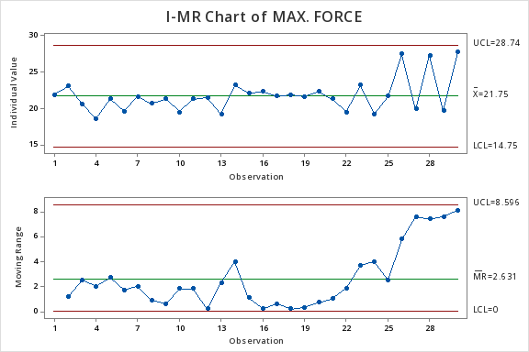
MEASURE
YFG RAIL FORCE DATA AT 5.5 MM BALL GUIDE
Cpk value is 6.74

Slide 8
WE CONDUCT 30 PART OF YTA TOOL FOR CHECK FORCE VARIATION IN SAME BALL GUIDE(BALL SIZE-5.5mm)
MEASURE

Slide 9
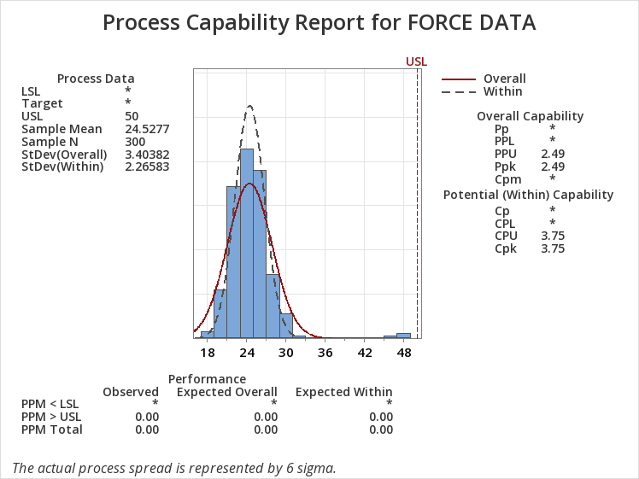
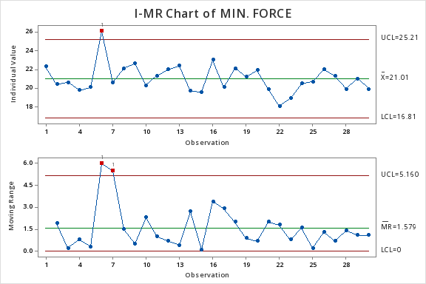
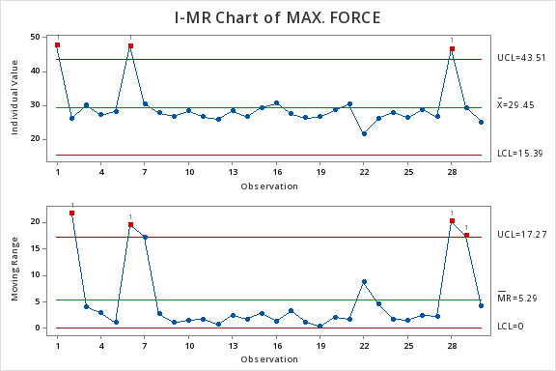
MEASURE
YTA RAIL FORCE DATA AT 5.5 MM BALL GUIDE
Cpk value is 3.75

Slide 10
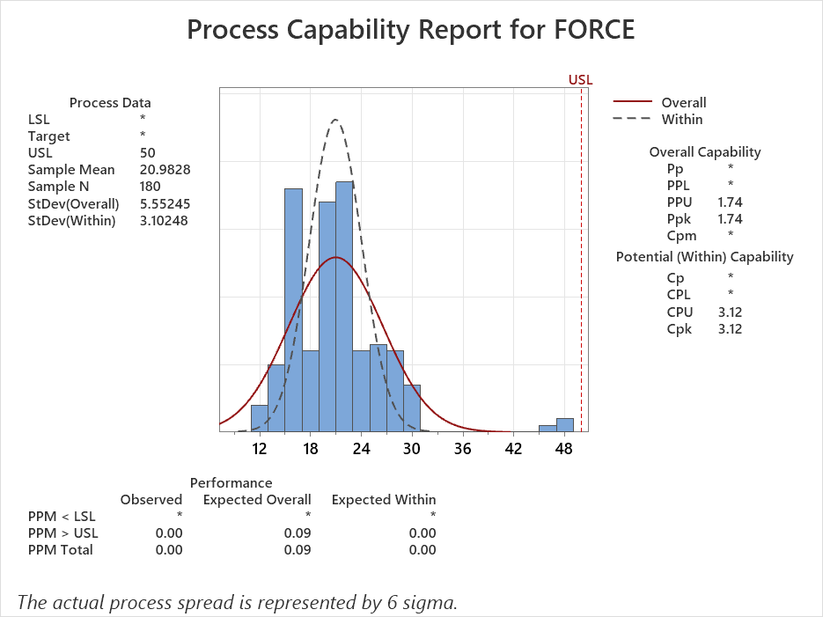
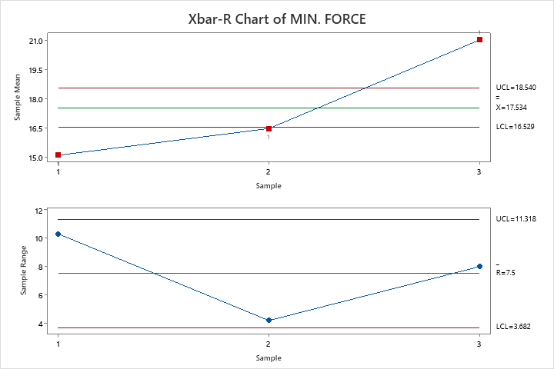
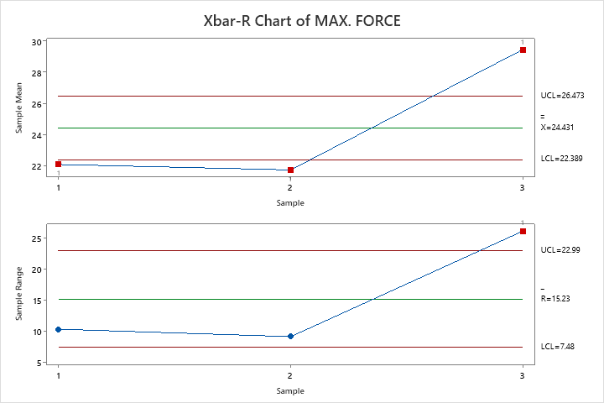
MEASURE
COMBINED FORCE DATA OF ALL RAIL IN 5.5 MM BALL GUIDE
CONCLUSION:- Capability is ok but Stability is not ok in all in-house rails with the same ball guide (5.5mm).
Cpk value is 3.12

Slide 11
WE CONDUCT 30 PART OF YY8 TOOL FOR CHECK FORCE VARIATION IN SAME BALL GUIDE(BALL SIZE-5.6mm)
MEASURE

Slide 12
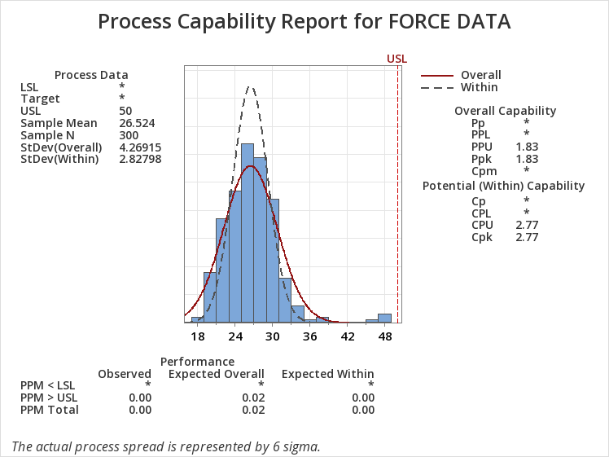
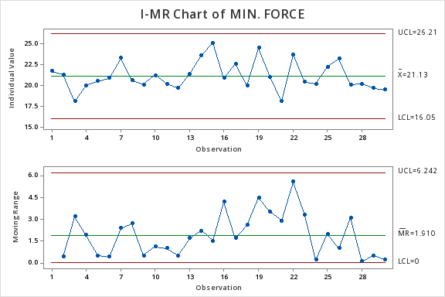
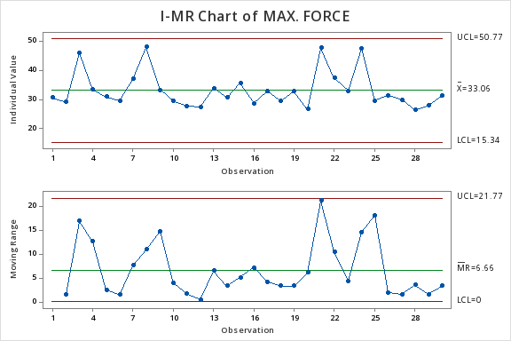
MEASURE
YY8 RAIL FORCE DATA AT 5.6 MM BALL GUIDE
Cpk value is 2.77

Slide 13
WE CONDUCT 30 PART OF YFG TOOL FOR CHECK FORCE VARIATION IN SAME BALL GUIDE(BALL SIZE-5.6mm)
MEASURE

Slide 14
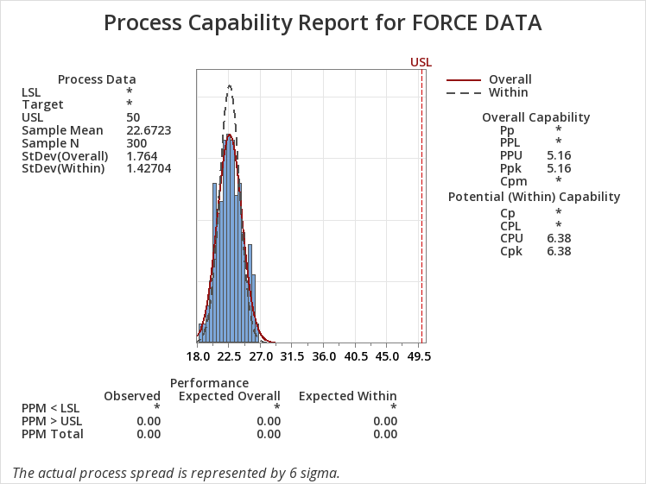
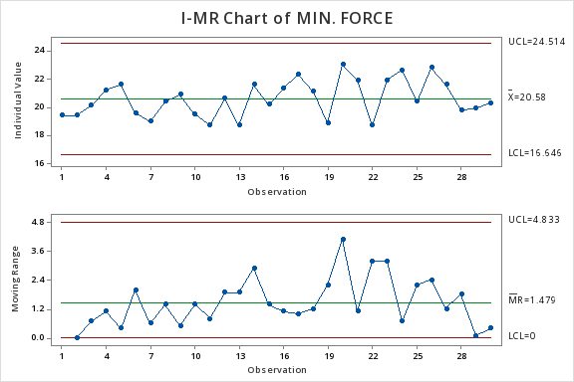
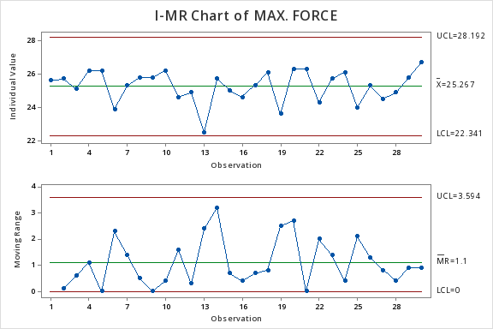
MEASURE
YFG RAIL FORCE DATA AT 5.6 MM BALL GUIDE
Cpk value is 6.38

Slide 15
WE CONDUCT 30 PART OF YTA TOOL FOR CHECK FORCE VARIATION IN SAME BALL GUIDE(BALL SIZE-5.6mm)
MEASURE

Slide 16
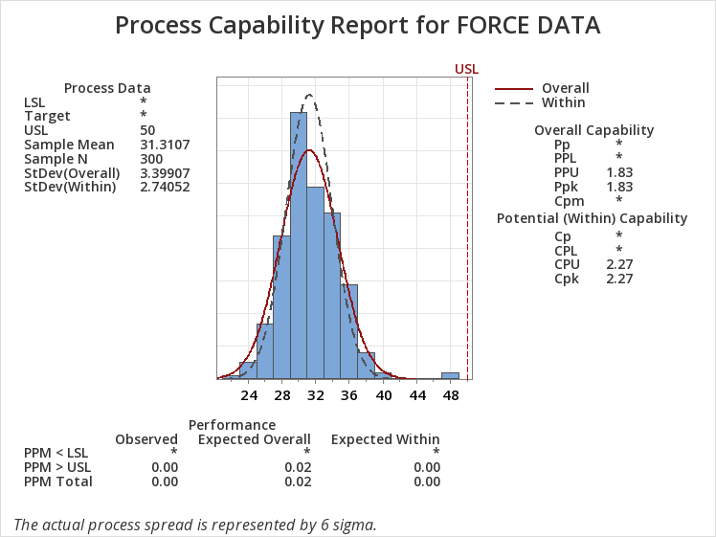
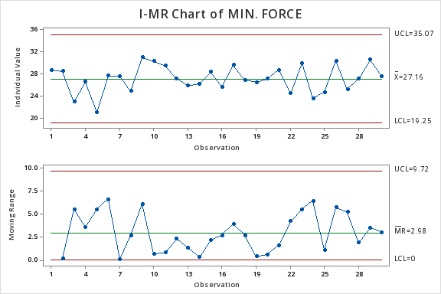
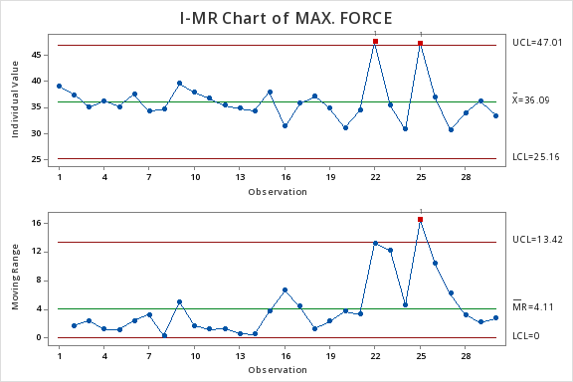
MEASURE
YTA RAIL FORCE DATA AT 5.6 MM BALL GUIDE
Cpk value is 2.27

Slide 17
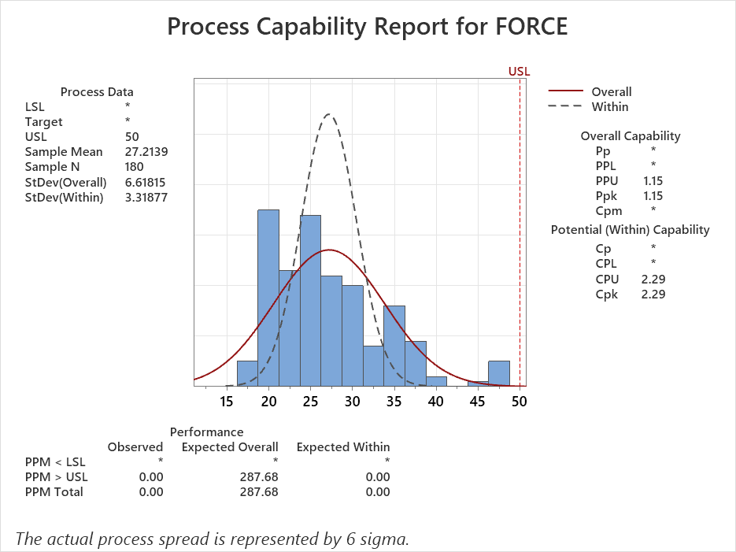
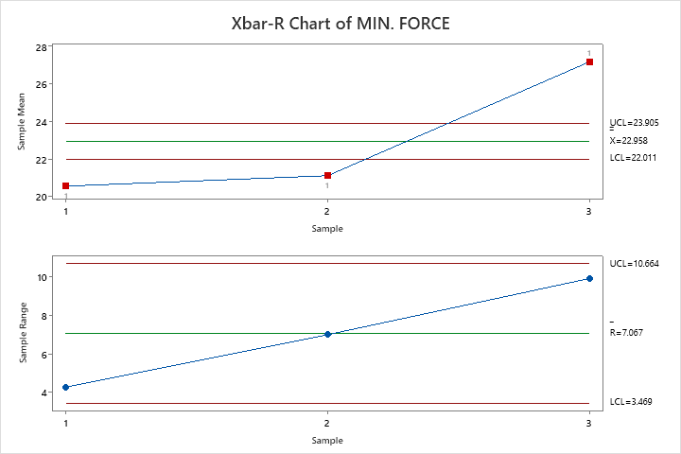
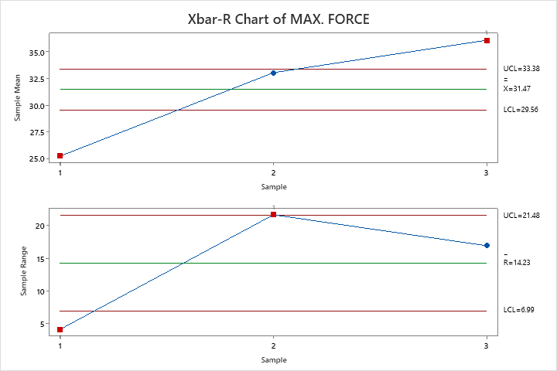
MEASURE
COMBINED FORCE DATA OF ALL RAIL IN 5.6 MM BALL GUIDE
CONCLUSION:- Again same result, Capability is ok but Stability is not ok in all in-house rails with the same ball guide (5.6mm).
Cpk value is 2.29

Slide 18
ANALYSIS
PROCESS MAPPING
Key Process Input Variables (KPIV)
INCOMING
PROCESS PARAMETERS
BOP & Child Parts
1 Guide
2 Lower Rail
3 Upper Rail
Previous Process Output
1. After welding upper rail deformation
2. After Tab bending lower rail deformation
Machine
1. Rod cylinder pressure
2 . Rod alignment not ok.
3. Rod surface wear-out
4. Guide holding clamp air pressure more/less.
5. Upper rail pressing clamp pressure more/less.
Tools/Jig/Fixture
1. Ball guide holding clamp loose.
2. Ball guide holding clamp magnet weak.
3. Upper rail holding block wear-out
4. Greasing not proper on jig sliding area
Human Variation
1. Area sensor fault during guide interstation
2. Guide Assy not properly placing on the clamp
Environment
N/A
PROCESS
Upper rail & Lower rail assy. Kept on guide pin
Ball guide kept on ball guide holder clamp
Lower rail guide with guide pin & hold with clamp
Upper rail squeezing by pusher clamp then ball guide clamp with upper rail in RR side
Ball guide insert in between upper and lower rail by pusher rod
Part slide from FR to RR by clamping holder
Operator part unload from machine and kept on semi-auto machine for force checking
Part come from original position for next process
Ball guide insert in between upper and lower rail by pusher rod
Upper rail squeezing by pusher clamp then ball guide clamp with upper rail in FR side
Key Process Output Variables (KPOV)
Min. & Max. sliding force

Slide 19
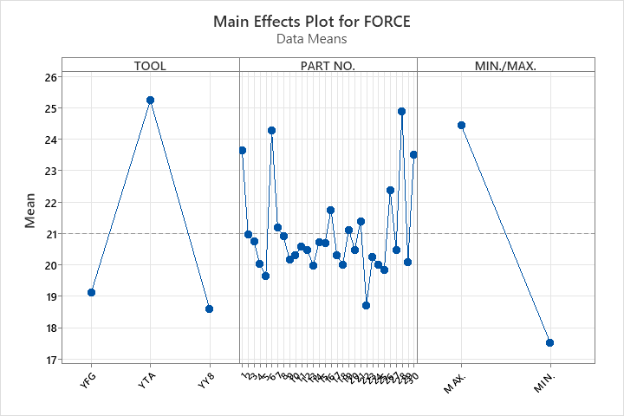
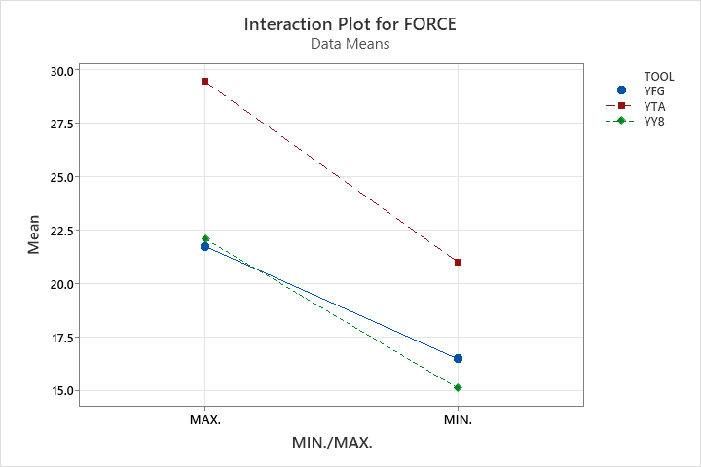
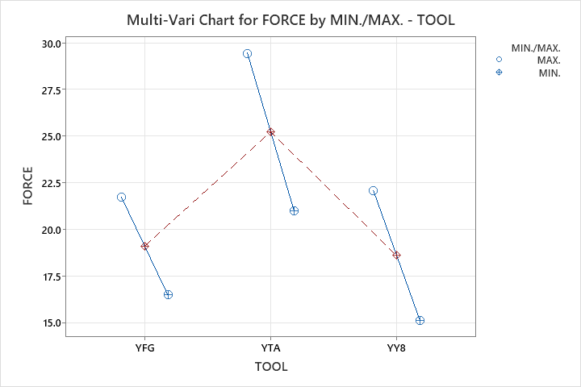
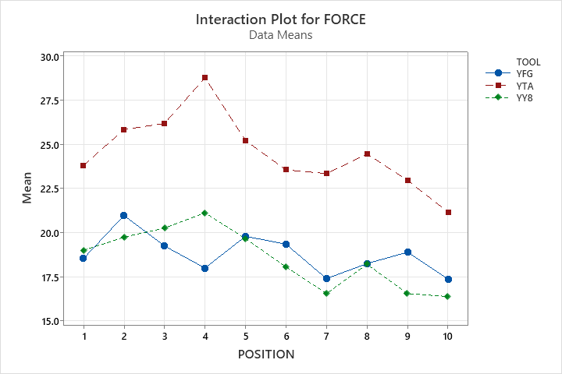
ANALYSIS
FORCE COMPARISON OF ALL RAIL in 5.5 mm BALL GUIDE
CONCLUSION:- Almost all KPIVs were the same; only the upper and lower rails were different. It was found that in 5.5 mm ball guides, the sliding force is different in all rails.

Slide 20
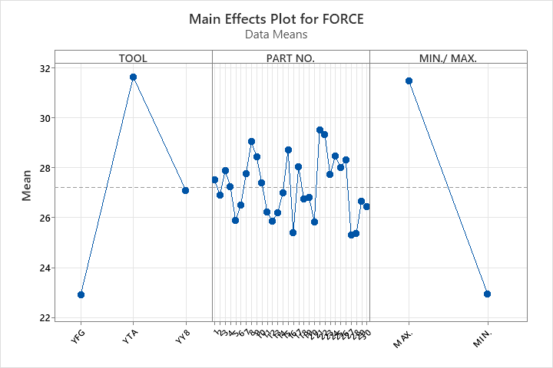
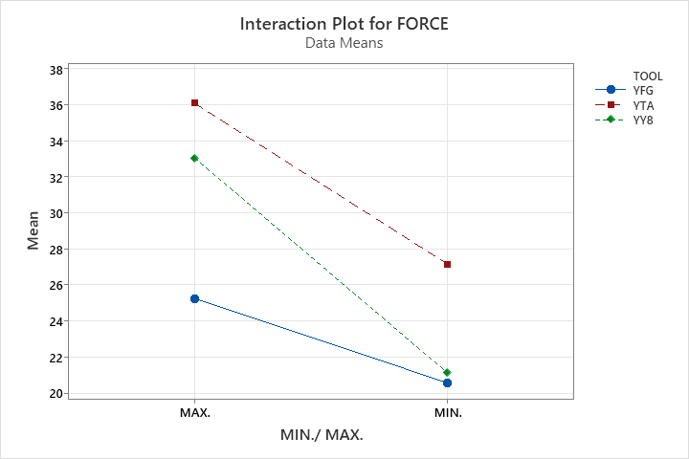
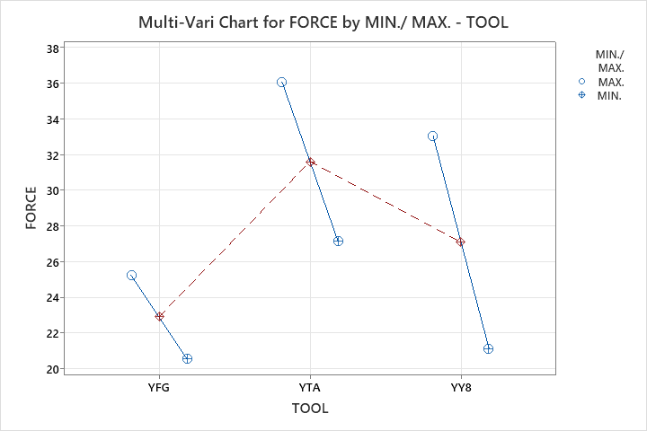
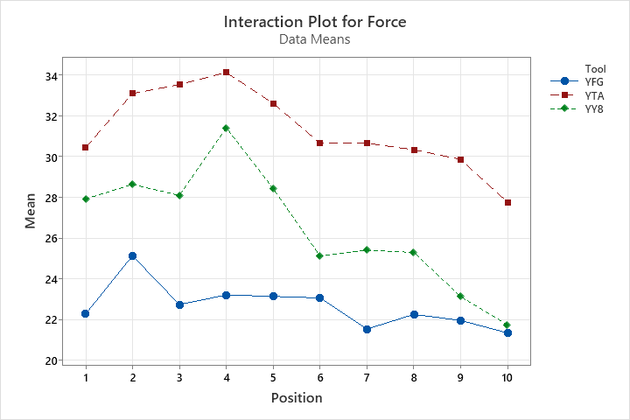
ANALYSIS
FORCE COMPARISON OF ALL RAIL in 5.6 mm BALL GUIDE
CONCLUSION:- Again almost all KPIVs were the same; only the upper and lower rails were different. It was found that in 5.6 mm ball guides, the sliding force is different in all rails.

Slide 21
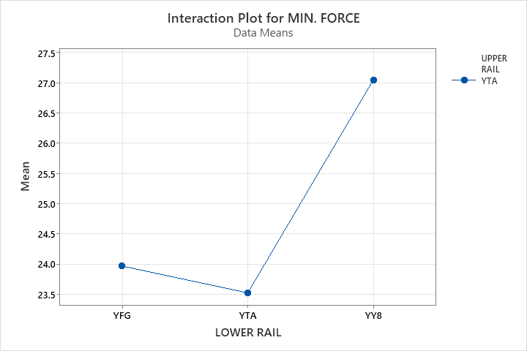
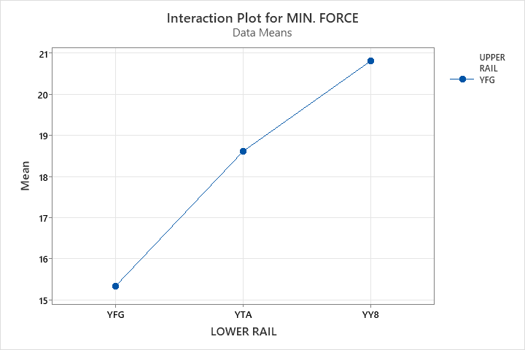
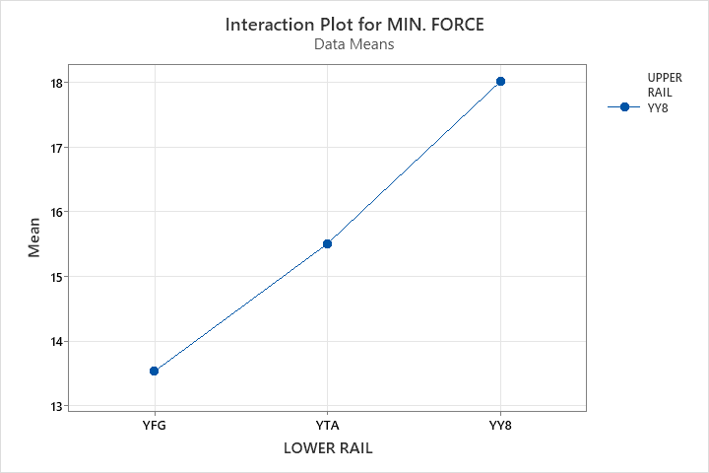
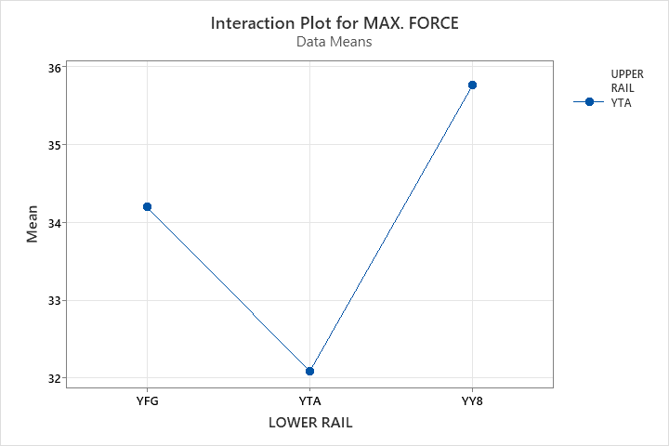
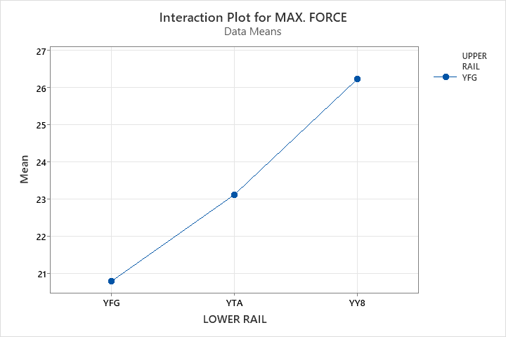
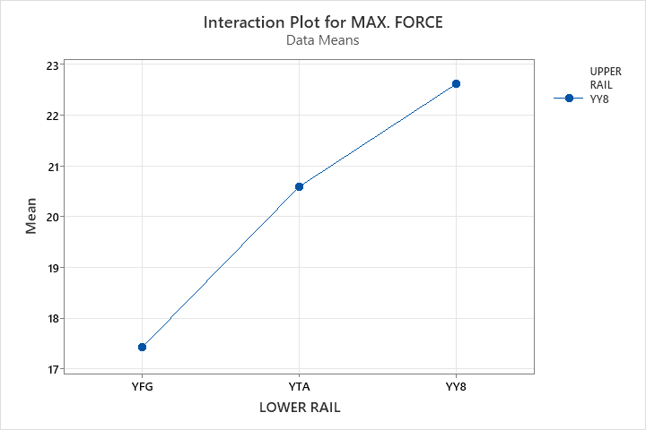
ANALYSIS
FORCE COMPARISON IN SAME UPPER RAIL
CONCLUSION:- The difference in sliding force due to the lower rail can be a minimum of 6.7N and a maximum of 20.1N

Slide 22
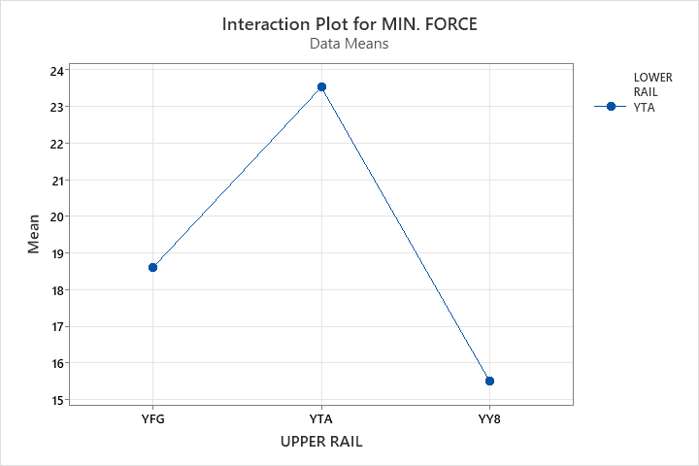
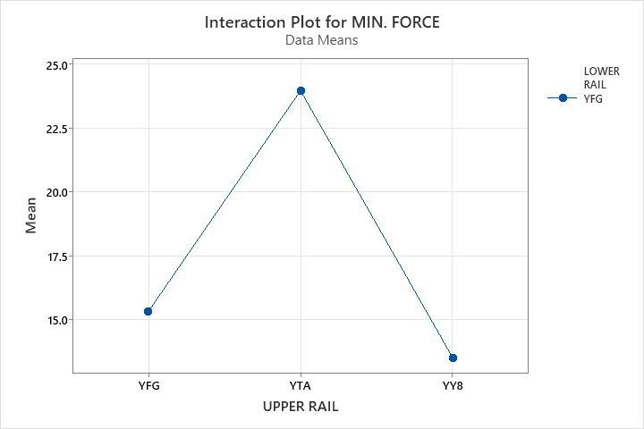
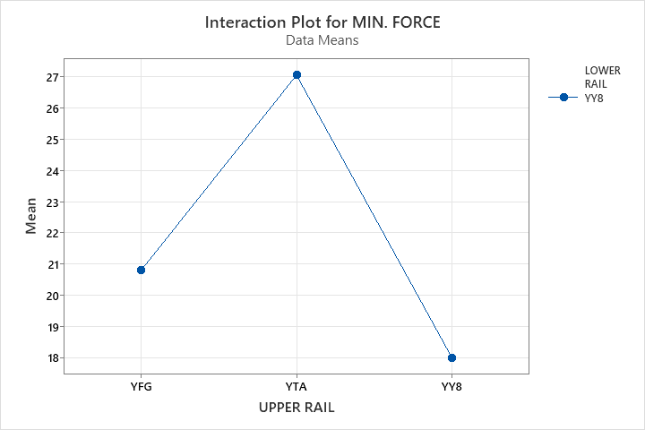
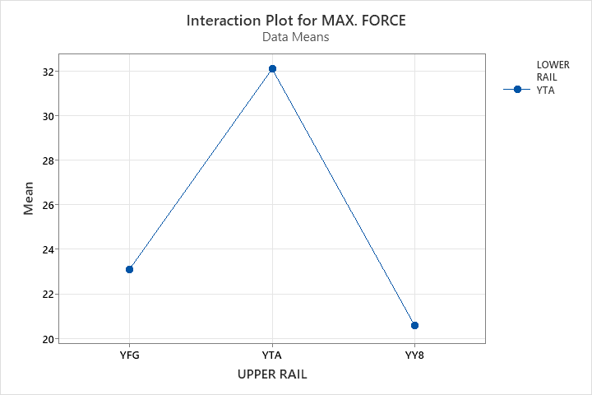
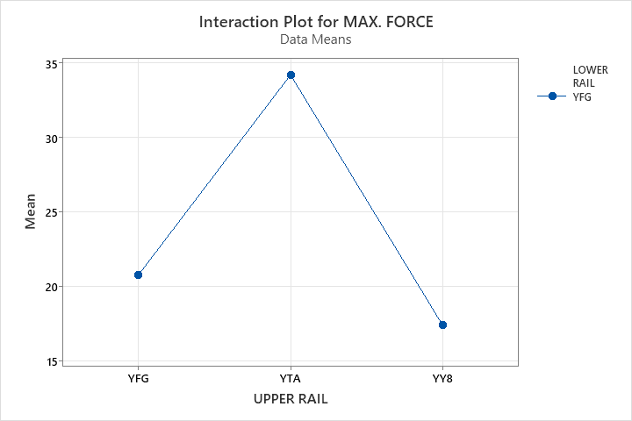
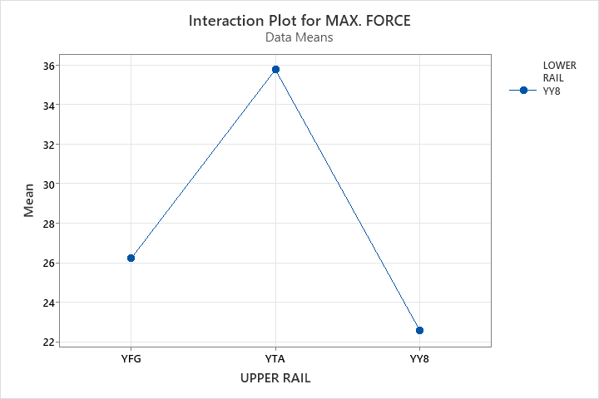
ANALYSIS
FORCE COMPARISON IN SAME LOWER RAIL
CONCLUSION:- The difference in sliding force due to the upper rail can be a minimum of 11.2N and a maximum of 31.3N

Slide 23
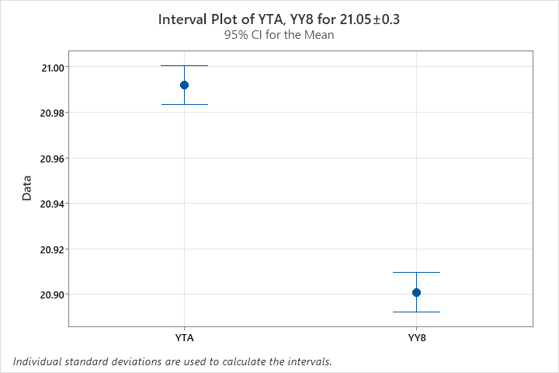
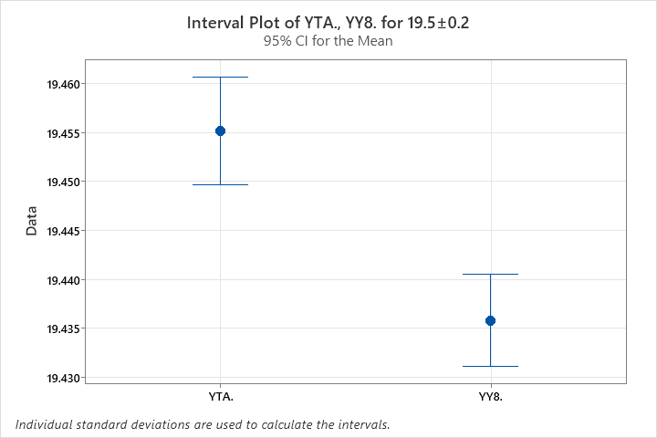
ANALYSIS
DIM. COMPARISION OF YTA & YY8 UPPER RAIL
YTA has a mean of ~20.99, close to the lower bound of the target range.
YY8 has a lower mean (~20.91), near the edge of the acceptable range.
YTA and YY8 have similar mean values, both within the expected range.
YTA appears slightly more aligned with the target value.
FINAL CONCLUSION:- Both parts mean is different, so there is a possibility of impact in sliding force.

Slide 24
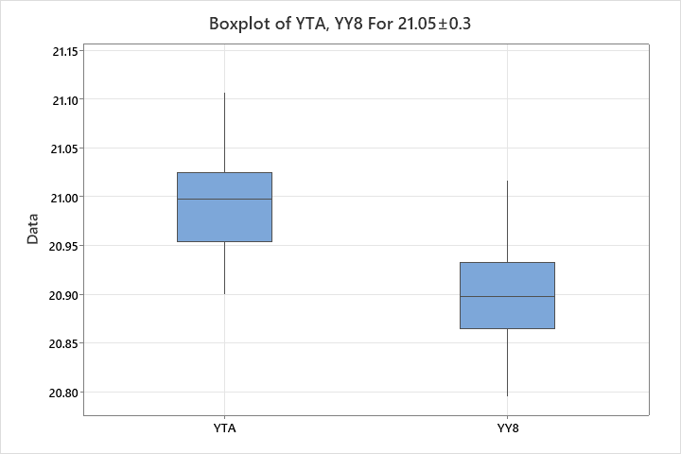
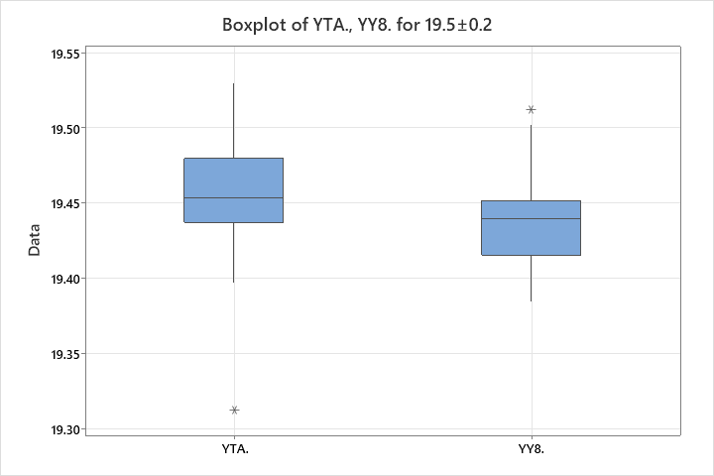
ANALYSIS
DIM. COMPARISION OF YTA & YY8 UPPER RAIL
YTA has a higher median (~21.00) and is more centered around the target value.
YY8 has a lower median (~20.90) and greater variability.
YTA demonstrates better consistency and alignment with the target range.
YTA and YY8 have similar medians (~19.45).
YTA shows slightly more variability with a wider interquartile range and a lower outlier (~19.30).
YY8 has a tighter spread but includes a high outlier (~19.54).
Both datasets are within the expected range, but YTA shows more dispersion.
FINAL CONCLUSION:-YTA values are closer to the target and more consistent than YY8, so there is a possibility of impact in sliding force.

Slide 25
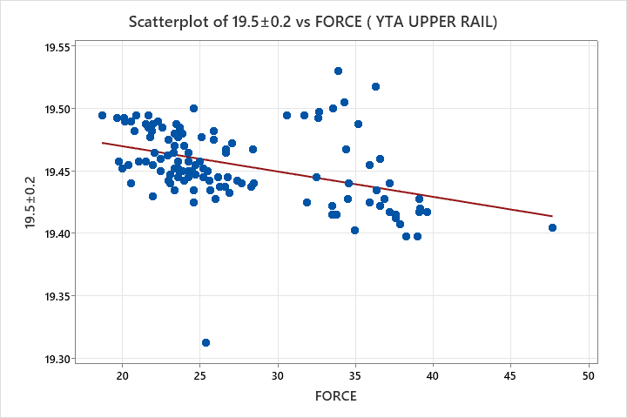



ANALYSIS
RELATION BETWEEN UPPER RAIL DIM. & FORCE
CONCLUSION:- No any relation found between upper rail Dim. and sliding force. So that this dimensions is not our significant cause.

Slide 26




ANALYSIS
RAIL PROFILE COMPARISION OF YTA & YY8 UPPER RAIL
CONCLUSION:- Both model ( YTA & YY8 ) profile is different so there is a possibility of impact in sliding force.

Slide 27


ANALYSIS
RADIUS(5.4) & RADIUS(3.4) COMPARISION OF YTA & YY8 UPPER RAIL
CONCLUSION:- Both model ( YTA & YY8 ) radius is different so there is a possibility of impact in sliding force.

Slide 28

ANALYSIS
RELATION BETWEEN UPPER RAIL PROFILE & FORCE
CONCLUSION:- We do not have enough data of profile, but the rest of the data indicates that there is a positive relationship between the profile of upper rail and the sliding force.

Slide 29
IMPROVE & CONTROL
We do not have a quick way to collect profile data because in CMM, the inspection time for one part is 2 hour, and it is not practical to do this on a daily basis. Therefore, after discussing with the quality team, a new profile inspection machine will be ordered with a target date of January 2026.
After purchasing the profile inspection machine, we will improve the profile of the upper rail and the lower rail. Also, the control will be according to the desired specifications of the sliding force.

Slide 30

Thank you

